Slide 1
Dynamic Memory Allocation

Slide 2
Dynamic Memory Allocation in C
Dynamic Memory Allocation can be defined as a procedure in which the size of a data structure (like Array) is changed during the runtime. C provides some functions to achieve these tasks. There are 4 library functions provided by C defined under <stdlib.h> header file to facilitate dynamic memory allocation in C programming. They are:
malloc()
calloc()
free()
realloc()

Slide 3
C malloc() method
The “malloc” or “memory allocation” method in C is used to dynamically allocate a single large block of memory with the specified size. It returns a pointer of type void which can be cast into a pointer of any form. It doesn’t Initialize memory at execution time so that it has initialized each block with the default garbage value initially.
Syntax:
ptr = (cast-type*) malloc(byte-size)
Example:
ptr = (int*) malloc(100 * sizeof(int));
the size of int is 4 bytes, this statement will allocate 400 bytes of memory. The pointer ptr holds the address of the first byte in the allocated memory.

Slide 4
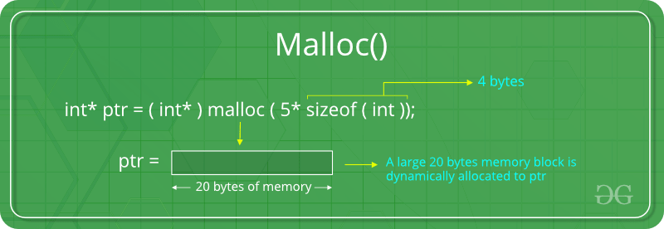

Slide 5
Program
// Check if the memory has been successfully
// allocated by malloc or not
if (ptr == NULL) {
printf("Memory not allocated.\n");
exit(0);
}
else {
// Memory has been successfully allocated
printf("Memory successfully allocated using malloc.\n");
// Get the elements of the array
for (i = 0; i < n; ++i) {
ptr[i] = i + 1;
}
// Print the elements of the array
printf("The elements of the array are: ");
for (i = 0; i < n; ++i) {
printf("%d, ", ptr[i]);
}
}
return 0;
}
#include <stdio.h>
#include <stdlib.h>
int main()
{
int* ptr;
int n, i;
// Get the number of elements for the array
printf("Enter number of elements:");
scanf("%d",&n);
printf("Entered number of elements: %d\n", n);
// Dynamically allocate memory using malloc()
ptr = (int*)malloc(n * sizeof(int));

Slide 6
Program2:
#include<stdio.h>
#include<stdlib.h>
int main(){
int n,i,*ptr,sum=0;
printf("Enter number of elements: ");
scanf("%d",&n);
ptr=(int*)malloc(n*sizeof(int));
//memory allocated using malloc
if(ptr==NULL)
{
printf("Sorry! unable to allocate memory");
exit(0);
}
printf("Enter elements of array: ");
for(i=0;i<n;++i)
{
scanf("%d",ptr+i);
sum+=*(ptr+i);
}
printf("Sum=%d",sum);
free(ptr);
return 0;
}

Slide 7
Calloc()
C calloc() method
“calloc” or “contiguous allocation” method in C is used to dynamically allocate the specified number of blocks of memory of the specified type. it is very much similar to malloc() but has two different points and these are:
It initializes each block with a default value ‘0’.
It has two parameters or arguments as compare to malloc().
Syntax:
ptr = (cast-type*)calloc(n, element-size);
here, n is the no. of elements and element-size is the size of each element.
Example:
ptr = (float*) calloc(25, sizeof(float));
This statement allocates contiguous space in memory for 25 elements each with the size of the float.

Slide 8
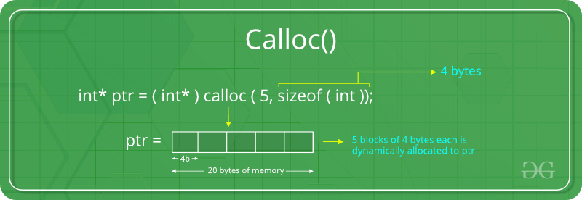

Slide 9
#include <stdio.h>
#include <stdlib.h>
int main()
{
// This pointer will hold the base address of the block
int* ptr;
int n, i;
// Get the number of elements for the array
n = 5;
printf("Enter number of elements: %d\n", n);
// Dynamically allocate memory using calloc()
ptr = (int*)calloc(n, sizeof(int));
// Check if the memory has been successfully
// allocated by calloc or not
if (ptr == NULL) {
printf("Memory not allocated.\n");
exit(0);
}
else {
// Memory has been successfully allocated
printf("Memory successfully allocated using calloc.\n");
// Get the elements of the array
for (i = 0; i < n; ++i) {
ptr[i] = i + 1;
}
// Print the elements of the array
printf("The elements of the array are: ");
for (i = 0; i < n; ++i) {
printf("%d, ", ptr[i]);
}
}
return 0;
}

Slide 10
C free() method
“free” method in C is used to dynamically de-allocate the memory. The memory allocated using functions malloc() and calloc() is not de-allocated on their own. Hence the free() method is used, whenever the dynamic memory allocation takes place. It helps to reduce wastage of memory by freeing it.
Syntax:
free(ptr);

Slide 11
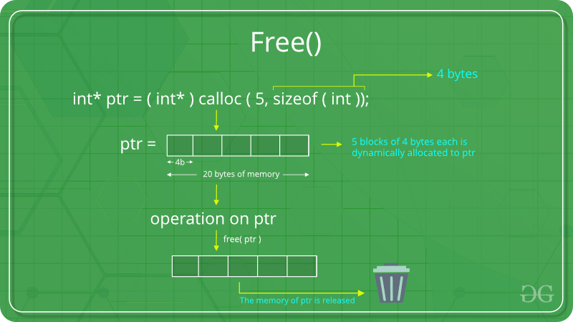

Slide 12
// Check if the memory has been successfully
// allocated by malloc or not
if (ptr == NULL || ptr1 == NULL) {
printf("Memory not allocated.\n");
exit(0);
}
else {
// Memory has been successfully allocated
printf("Memory successfully allocated using malloc.\n");
// Free the memory
free(ptr);
printf("Malloc Memory successfully freed.\n");
// Memory has been successfully allocated
printf("\nMemory successfully allocated using calloc.\n");
// Free the memory
free(ptr1);
printf("Calloc Memory successfully freed.\n");
}
return 0;
}
#include <stdio.h>
#include <stdlib.h>
int main()
{
// This pointer will hold the
// base address of the block created
int *ptr, *ptr1;
int n, i;
// Get the number of elements for the array
n = 5;
printf("Enter number of elements: %d\n", n);
// Dynamically allocate memory using malloc()
ptr = (int*)malloc(n * sizeof(int));
// Dynamically allocate memory using calloc()
ptr1 = (int*)calloc(n, sizeof(int));

Slide 13
C realloc() method
“realloc” or “re-allocation” method in C is used to dynamically change the memory allocation of a previously allocated memory. In other words, if the memory previously allocated with the help of malloc or calloc is insufficient, realloc can be used to dynamically re-allocate memory. re-allocation of memory maintains the already present value and new blocks will be initialized with the default garbage value.
Syntax:
ptr = realloc(ptr, newSize);
where ptr is reallocated with new size 'newSize'.

Slide 14
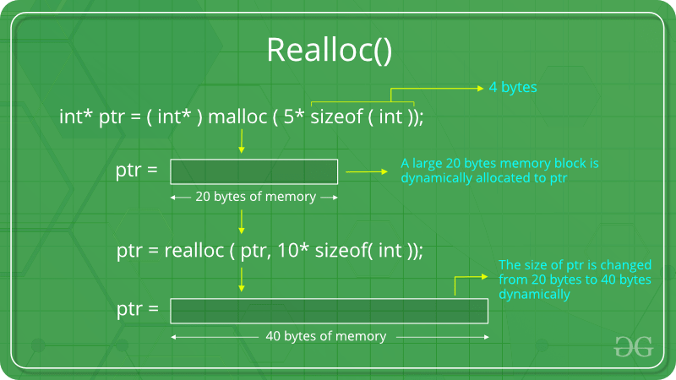

Slide 15
#include <stdio.h>
#include <stdlib.h>
int main()
{
// This pointer will hold the base address of the block created
int* ptr;
int n, i;
// Get the number of elements for the array
n = 5;
printf("Enter number of elements: %d\n", n);
// Dynamically allocate memory using calloc()
ptr = (int*)calloc(n, sizeof(int));
// Check if the memory has been successfully
// allocated by malloc or not
if (ptr == NULL) {
printf("Memory not allocated.\n");
exit(0);
}
else {

Slide 16
// Memory has been successfully allocated
printf("Memory successfully allocated using calloc.\n");
// Get the elements of the array
for (i = 0; i < n; ++i) {
ptr[i] = i + 1;
}
// Print the elements of the array
printf("The elements of the array are: ");
for (i = 0; i < n; ++i) {
printf("%d, ", ptr[i]);
}
// Get the new size for the array
n = 10;
printf("\n\nEnter the new size of the array: %d\n", n);
// Dynamically re-allocate memory using realloc()
ptr = realloc(ptr, n * sizeof(int));
// Memory has been successfully allocated
printf("Memory successfully re-allocated using realloc.\n");

Slide 17
// Get the new elements of the array
for (i = 5; i < n; ++i) {
ptr[i] = i + 1;
}
// Print the elements of the array
printf("The elements of the array are: ");
for (i = 0; i < n; ++i) {
printf("%d, ", ptr[i]);
}
free(ptr);
}
return 0;
}

Slide 18
#include <stdio.h>
#include <stdlib.h>
int main()
{
int index = 0, i = 0, n,
*marks; // this marks pointer hold the base address
// of the block created
int ans;
marks = (int*)malloc(sizeof(
int)); // dynamically allocate memory using malloc
// check if the memory is successfully allocated by
// malloc or not?
if (marks == NULL) {
printf("memory cannot be allocated");
}

Slide 19
else {
// memory has successfully allocated
printf("Memory has been successfully allocated by "
"using malloc\n");
printf("\n marks = %pc\n",
marks); // print the base or beginning
// address of allocated memory
do {
printf("\n Enter Marks\n");
scanf("%d", &marks[index]); // Get the marks
printf("would you like to add more(1/0): ");
scanf("%d", &ans);

Slide 20
if (ans == 1) {
index++;
marks = (int*)realloc(
marks,
(index + 1)
* sizeof(
int)); // Dynamically reallocate memory by using realloc
// check if the memory is successfully allocated by realloc or not?
if (marks == NULL) {
printf("memory cannot be allocated");
}
else {
printf("Memory has been successfully allocated using realloc:\n");
printf( "\n base address of marks are:%pc",marks);
//print the base or beginning address of allocated memory
}
}
} while (ans == 1);

Slide 21
// print the marks of the students
for (i = 0; i <= index; i++) {
printf("marks of students %d are: %d\n ", i, marks[i]);
}
free(marks);
}
return 0;
}

Slide 22
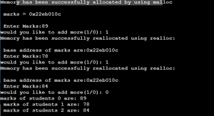

Slide 23
Example:Dynamic Structure
#include <stdio.h>
#include <stdlib.h>
struct course {
int marks;
char subject[30];
};
int main() {
struct course *ptr;
int noOfRecords;
printf("Enter the number of records: ");
scanf("%d", &noOfRecords);
// Memory allocation for noOfRecords structures
ptr = (struct course *)malloc(noOfRecords * sizeof(struct course));
for (int i = 0; i < noOfRecords; ++i) {
printf("Enter subject and marks:\n");
scanf("%s %d", (ptr + i)->subject, &(ptr + i)->marks);
}
printf("Displaying Information:\n");
for (int i = 0; i < noOfRecords; ++i) {
printf("%s\t%d\n", (ptr + i)->subject, (ptr + i)->marks);
}
free(ptr);
return 0;
}

